Slide 1
Git, Github, & Shell/Terminal
Notes:
Version control

Slide 2
Git & Github
Git: version control software
manages changes to a project without overwriting any part of that project
Github
visual interface to help you manage your version-controlled projects locally
https://naecker-lab.github.io/

Slide 3
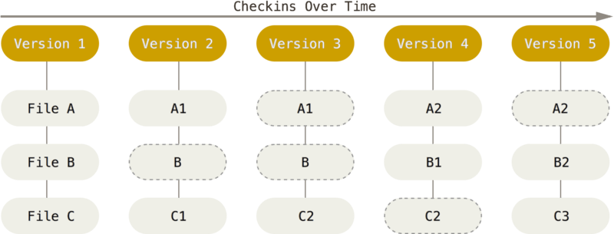
How Does Git Work?
Git thinks of data like a stream of snapshots
Every time you commit (save the state of your project), Git takes a snapshot of what all the files look like at that moment, and stores a reference to that snapshot

Slide 4
Download Git
First make a Github account
https://git-scm.com/book/id/v2/Getting-Started-Installing-Git
Download git for Mac: https://git-scm.com/download/mac
Download git for Windows: https://git-for-windows.github.io
Download git for Linux: https://git-scm.com/book/en/v2/Getting-Started-Installing-Git

Slide 5
Terminal Commands
git config --global user.name “Sarah Xu”
git config --global user.email sxu@wesleyan.edu
Make sure the user email is the same as the email you used to create your Github account

Slide 6
Navigate in terminal to whatever directory you want
On Github, go to the repository you’ll be working on
Press the green button, copy the link
In terminal, type: git clone <link>
Now the folder for this repository is inside

Slide 7
States and Workflow
When you are working on the project, there are two locations of the project:
Local: on your computer – this is where you will make changes to the code, and can run the code to see if it works
Github: this is where the final correct code will be located (master)
3 main states that the files reside in
Committed: data is safely stored in your local database
Modified: you have changed the file but have not committed it yet
Staged: you have marked a modified file in its current version to go into your next commit snapshot
Workflow
Modify files in your local working directory
Stage the files – adding snapshots of them to your staging area
Commit – which takes the files as they are in the staging area and stores that snapshot permanently in Git

Slide 8
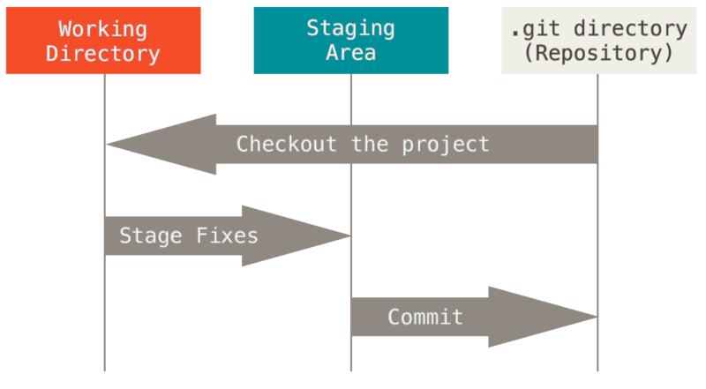
Stages

Slide 9
Making changes
Make sure you’re in the directory where the code is inside.
Type: git pull origin master
Will explain later
Now you can open the file and make changes to the code.
The file is now in the modified state
Once you have made changes, stage the file to signal that it is ready to be committed
Type: git add .
Now commit the changes
Type: git commit –m “description of your edits”
Reflect the changes to master file
Type: git push origin master

Slide 10
Skipping the Staging Area
Instead of typing git add . and then git commit –m “description of edits”
Shortcut: git commit –a –m “description of edits”

Slide 11
Before Anything Else..
Want to work on the most up-to-date version of the repository
“pull” the changes down from GitHub
git pull origin master

Slide 12
Local → Master
Any changes you make to the code on your computer will not reflect in master file until you push it
git push origin master

Slide 13
Terminal Commands
git pull origin master
Make the changes in your code
git commit –a –m “description of edits”
git push origin master
Remember to be inside the directory where the code is!

Slide 14
Other Useful Things to Know
Git diff
Log
Checkout
Merge conflicts

Slide 15
Git Diff
Allows you to see the changes you made

Slide 16
Log & Checkout
Allows you to see all previous commits (from everyone who has pushed changes)
Can use the commit ID to go back to an older version
Useful if you want to start over from a certain point

Slide 17
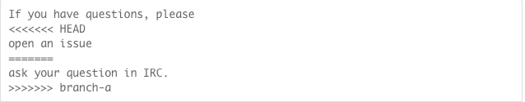
Merge Conflict
Working on different files – OK
Working on same file, but different parts – OK
Working on same file, same area – Problem
Decide what to keep, then commit and push

